Slide 1

Olympic Data Analysis
GROUP – 5
DATA SCIENCE LAB 1

Slide 2
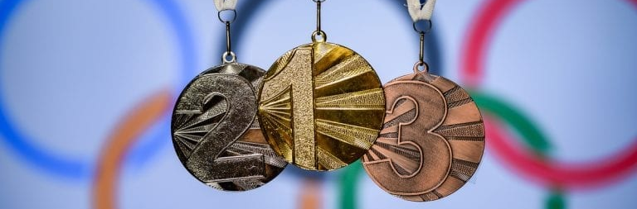
Why THIS PROJECT
Olympics – huge source of data
Importance of analyzing Olympic data
Analyzing opponent’s strength and weakness
Monitoring fitness level and injury situations
Choosing suitable genre for the players

Slide 3
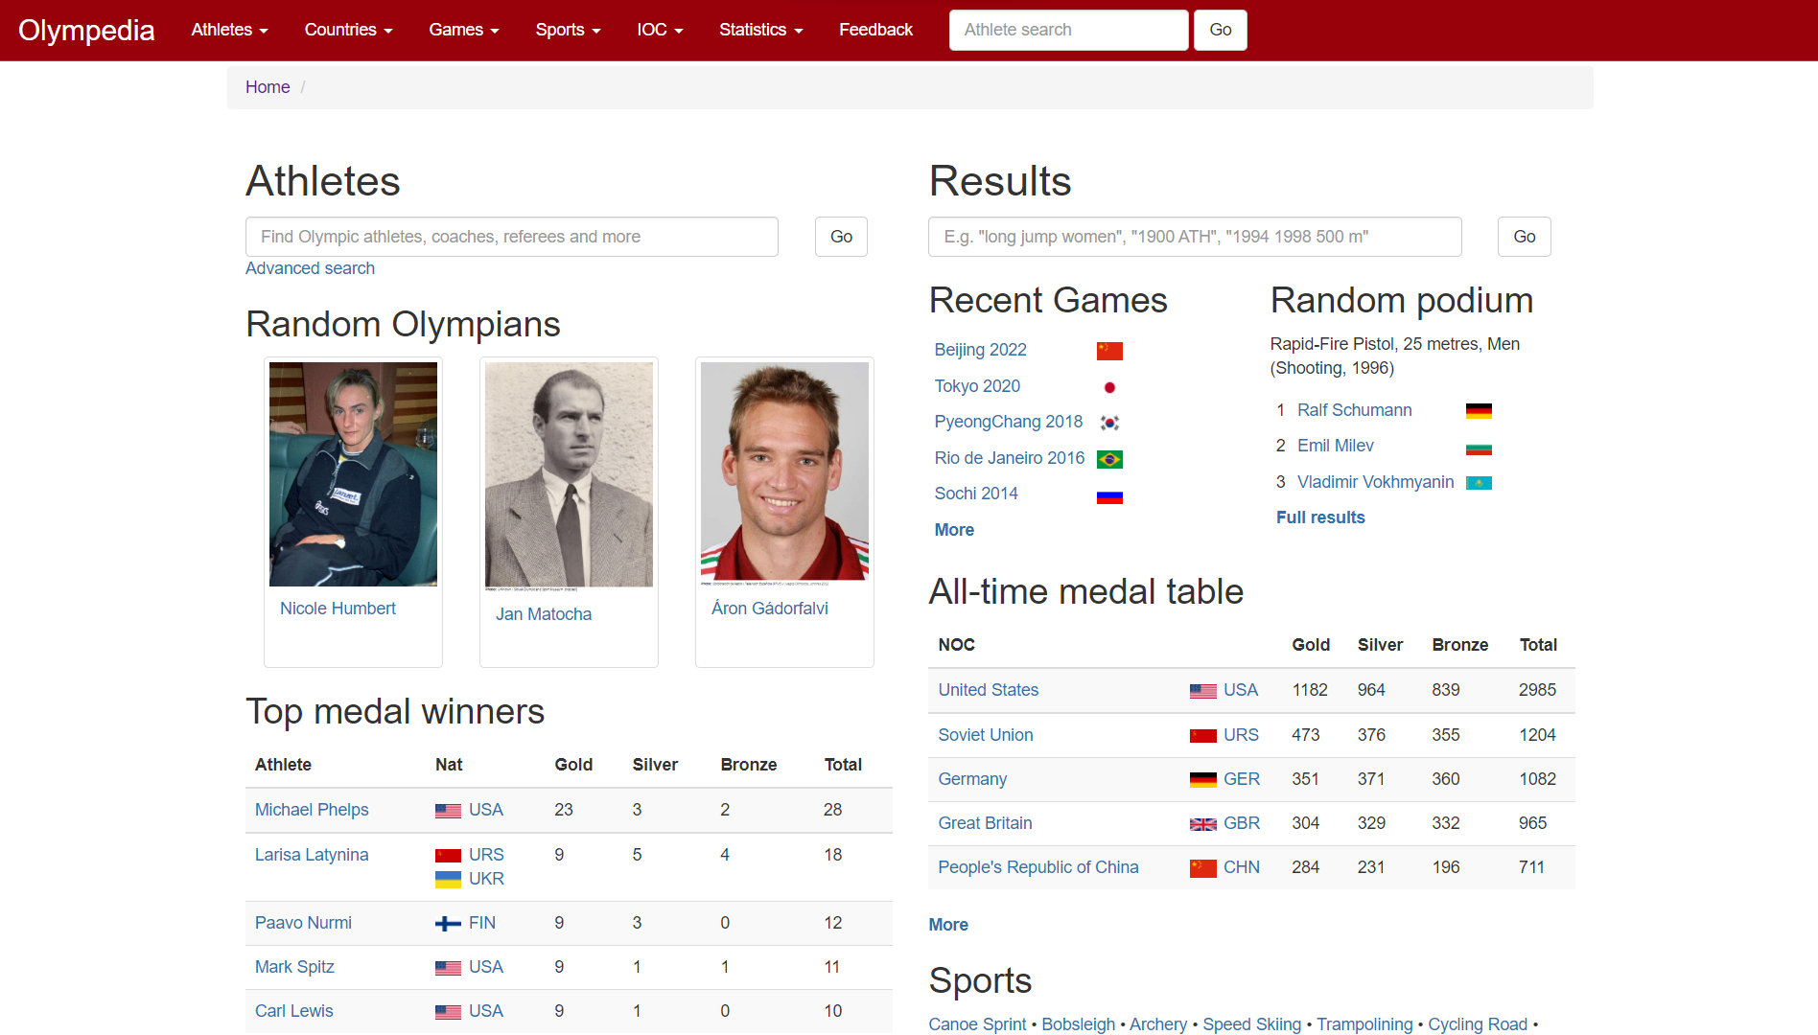
WEBSITE
http://www.olympedia.org/

Slide 4
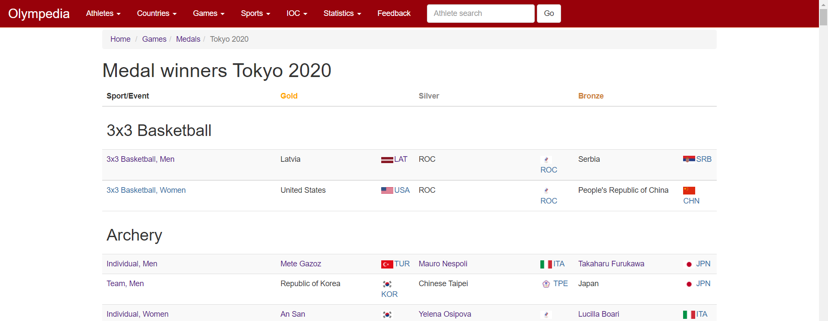
DATA DESCRIPTION
Data was collected on last 10 summer Olympics (Los Angeles 1984 – Tokyo 2020)
Variables :
Name and type of the events
Type of the medals
Name and country of the medal winners
Age , height and weight of the medal winners

Slide 5
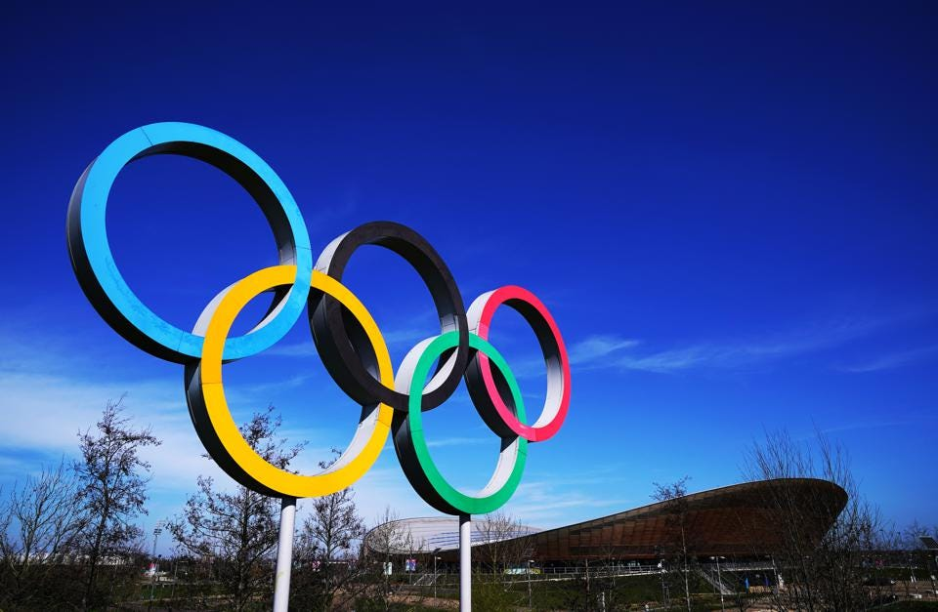
DATA
SCRAPING

Slide 6
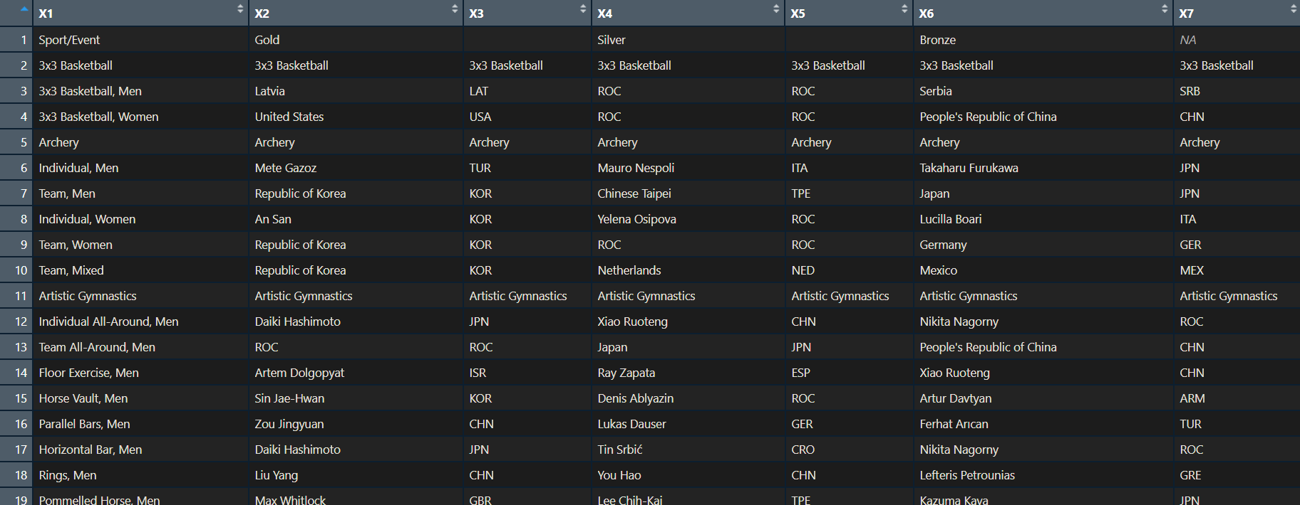
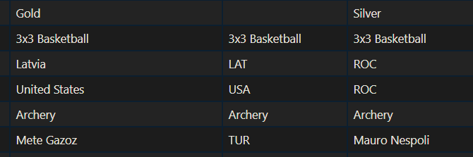
STEPS AND ISSUES
HTML-table
1. Country name in medal winners’ list indicates team event.
2. Player’s name in medal winners’ list indicates individual event.

Slide 7

STEPS and issues … continued
PRESENCE OF JOINT WINNERS :
To segregate names of the joint winners, we use ‘gsub’ function.
PATTERN : a small alphabet followed by a Capital alphabet.

Slide 8
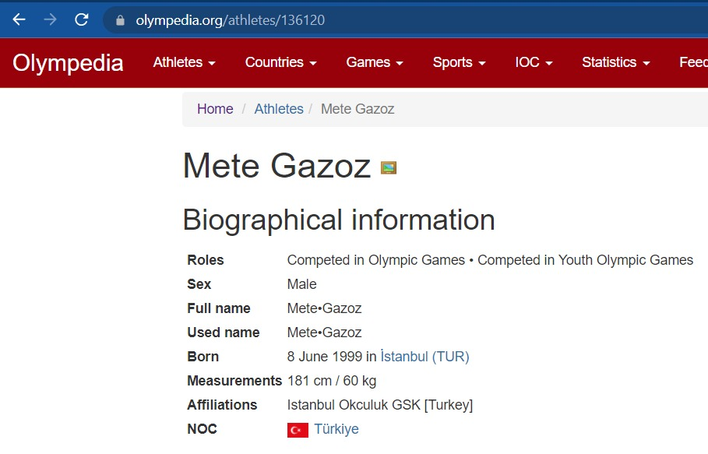
STEPS AND ISSUES … continued
Collecting players’ information (Age, Height, Weight) :
Identifying players’ using unique-ID.
Age Calculated using DOB
Measurements of players (Height / Weight)

Slide 9
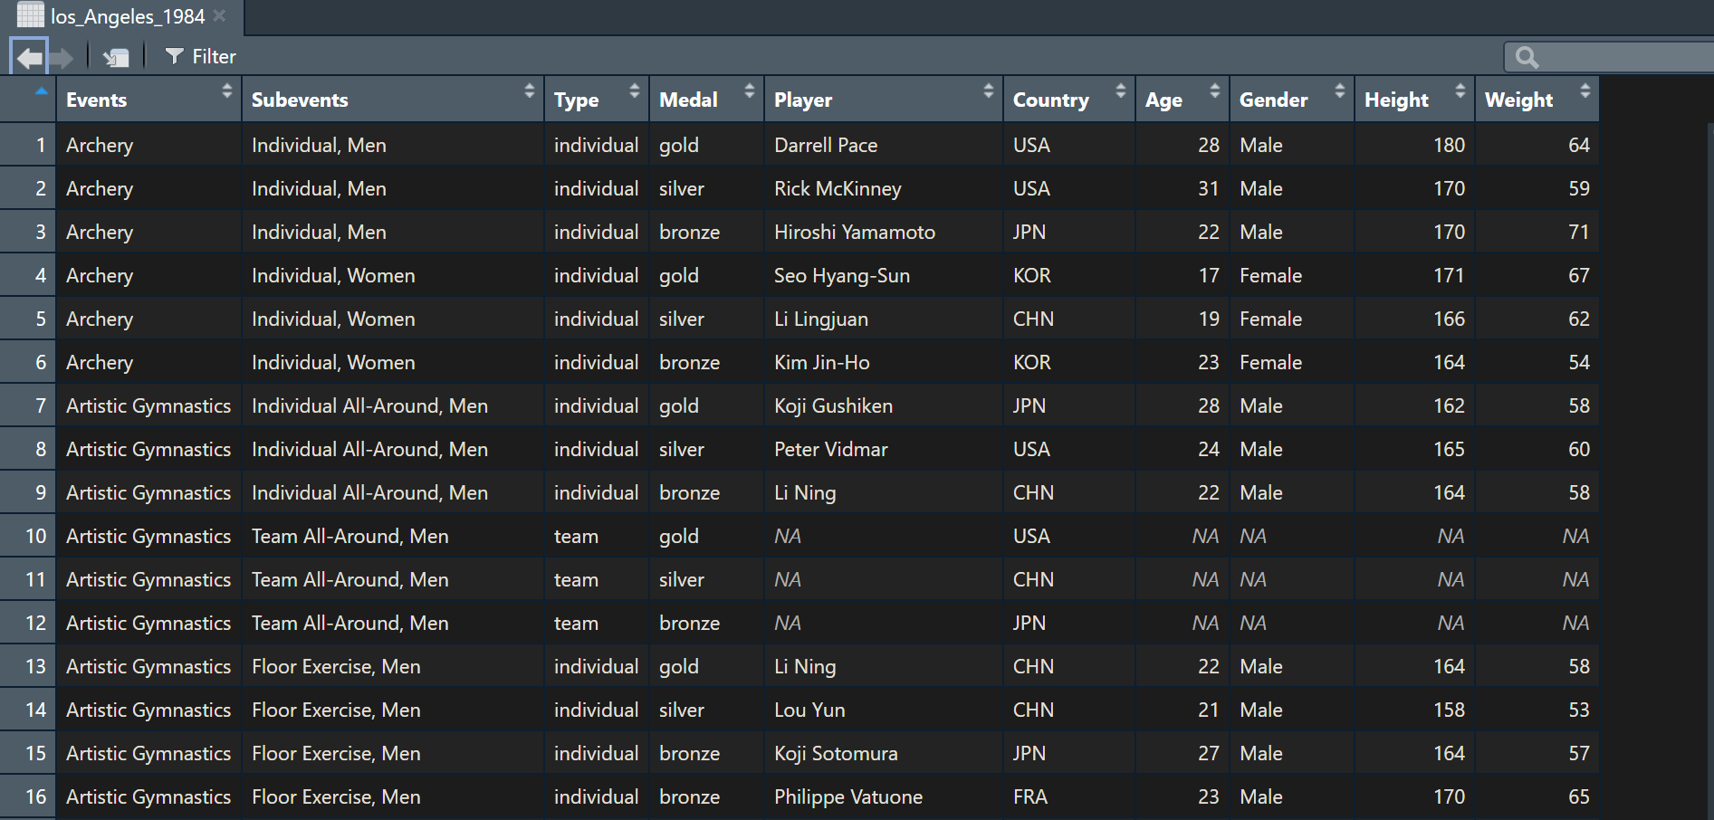
FINAL DATAFRAME

Slide 10
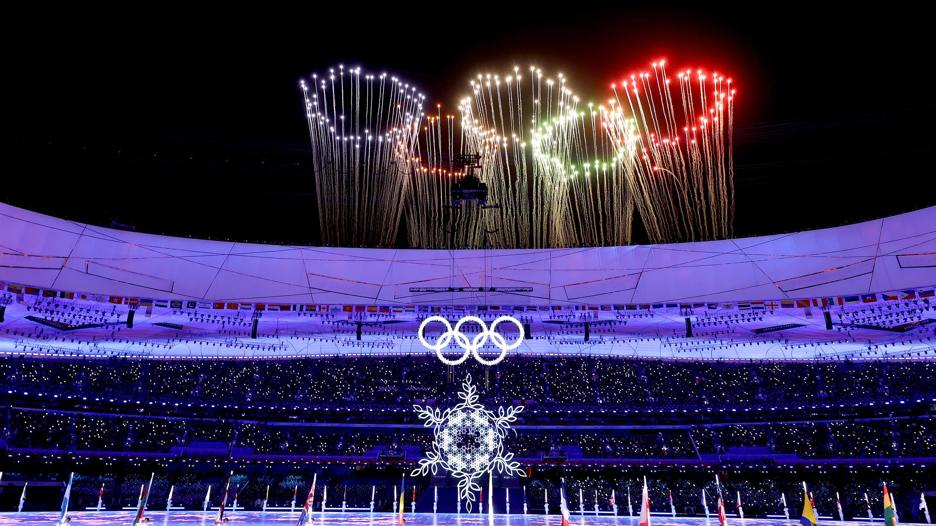
KEY QUESTIONS
OF INTEREST

Slide 11



Questions
MEDAL DISTRIBUTION
Gender distribution
Domination of countries
Which countries dominate in which Olympic sports?
Which factors affect the total medals won by different countries?
Does the Olympics show gender equality?

Slide 12



Questions
Effect of age
Effect of height and weight
EFFECT OF GDP
Does age impact the number of medals?
How important are heights and weights to win a medal?
How is GDP of a country related to number of medals?

Slide 13

SOME IMPORTANT
VISUALIZATIONS

Slide 14
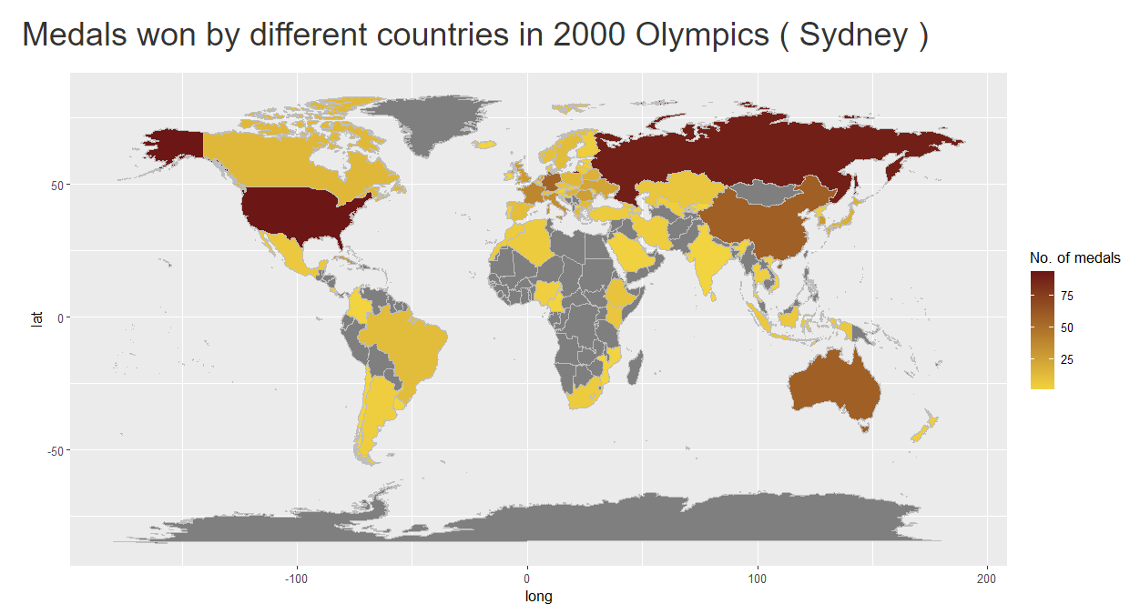
PLOT OF MEDAL DISTRIBUTION ON WORLD MAP
The world map is drawn using ‘mapdata’ in ‘R’.
The X and Y axes denote latitude and longitude of every places in the world.
Colors are given based on number of medals won by countries.

Slide 15
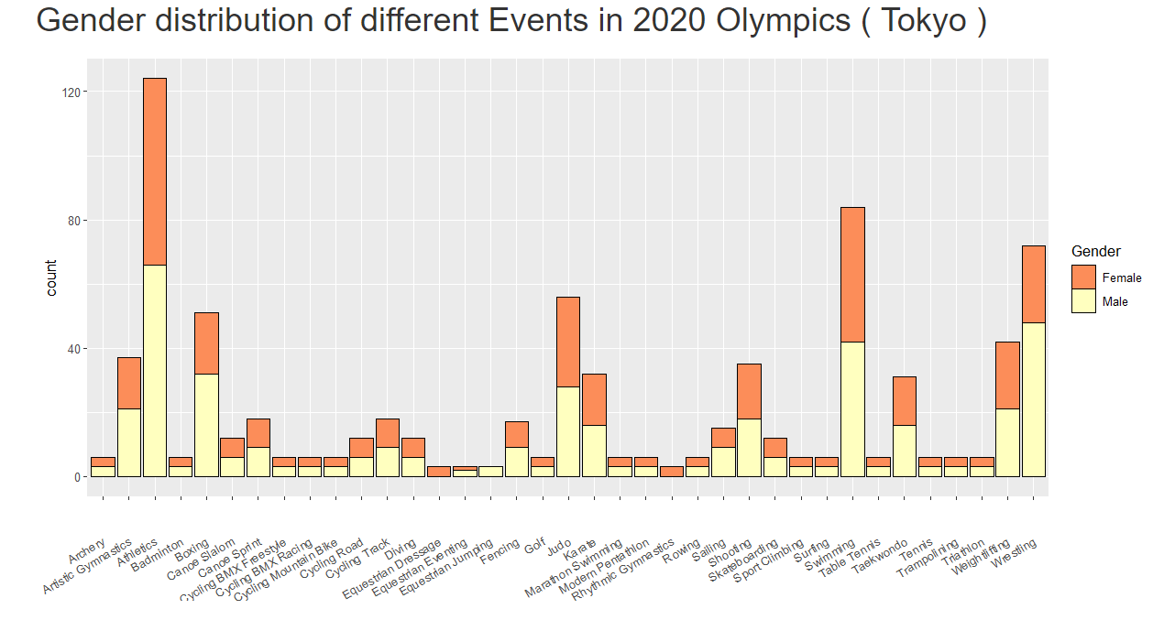
GENDER DISTRIBUTION IN DIFFERENT SPORTS
Barplot of number of medal winners in different sports are plotted.
In each bar, number of male and female winners are mentioned by two colors.

Slide 16
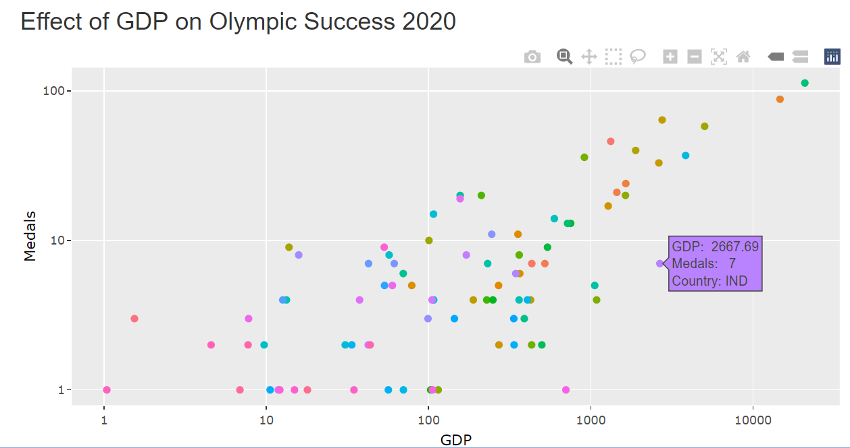
EFFECT OF GDP
Scatter plot is drawn on GDP of each country vs number of medals won by them.
Each country is denoted by different colors.

Slide 17
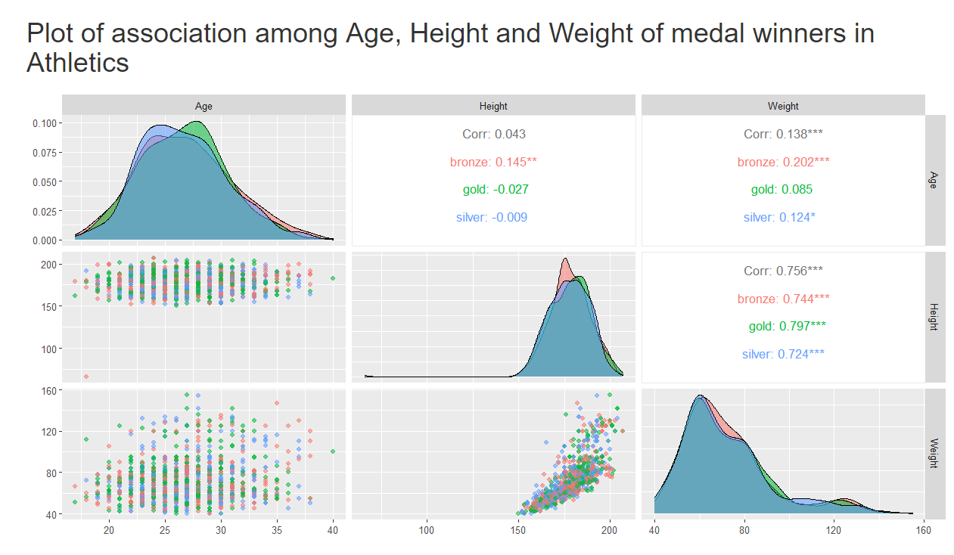
ASSOCIATION AMONG AGE, HEIGHT AND WEIGHT
Age, Height and Weight distributions are drawn for each event.
Scatter plot between every pair of the factors are drawn.

Slide 18
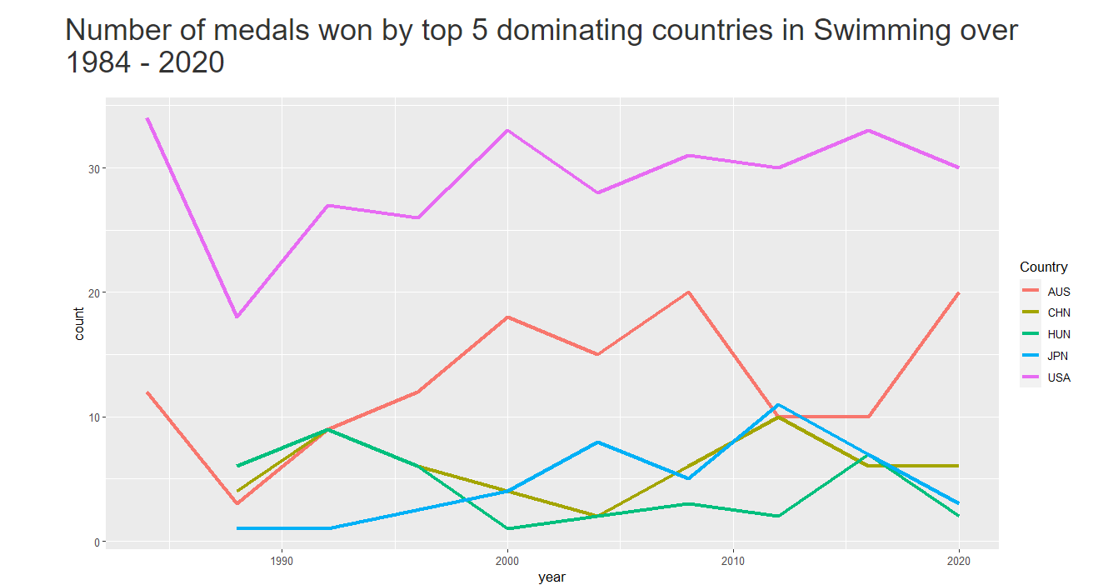
DOMINATION OF COUNTRIES IN DIFFERENT SPORTS
Top 5 dominating countries in each sports are identified.
Number of medals won by those countries are plotted over years.

Slide 19

SHINY
APP

Slide 20
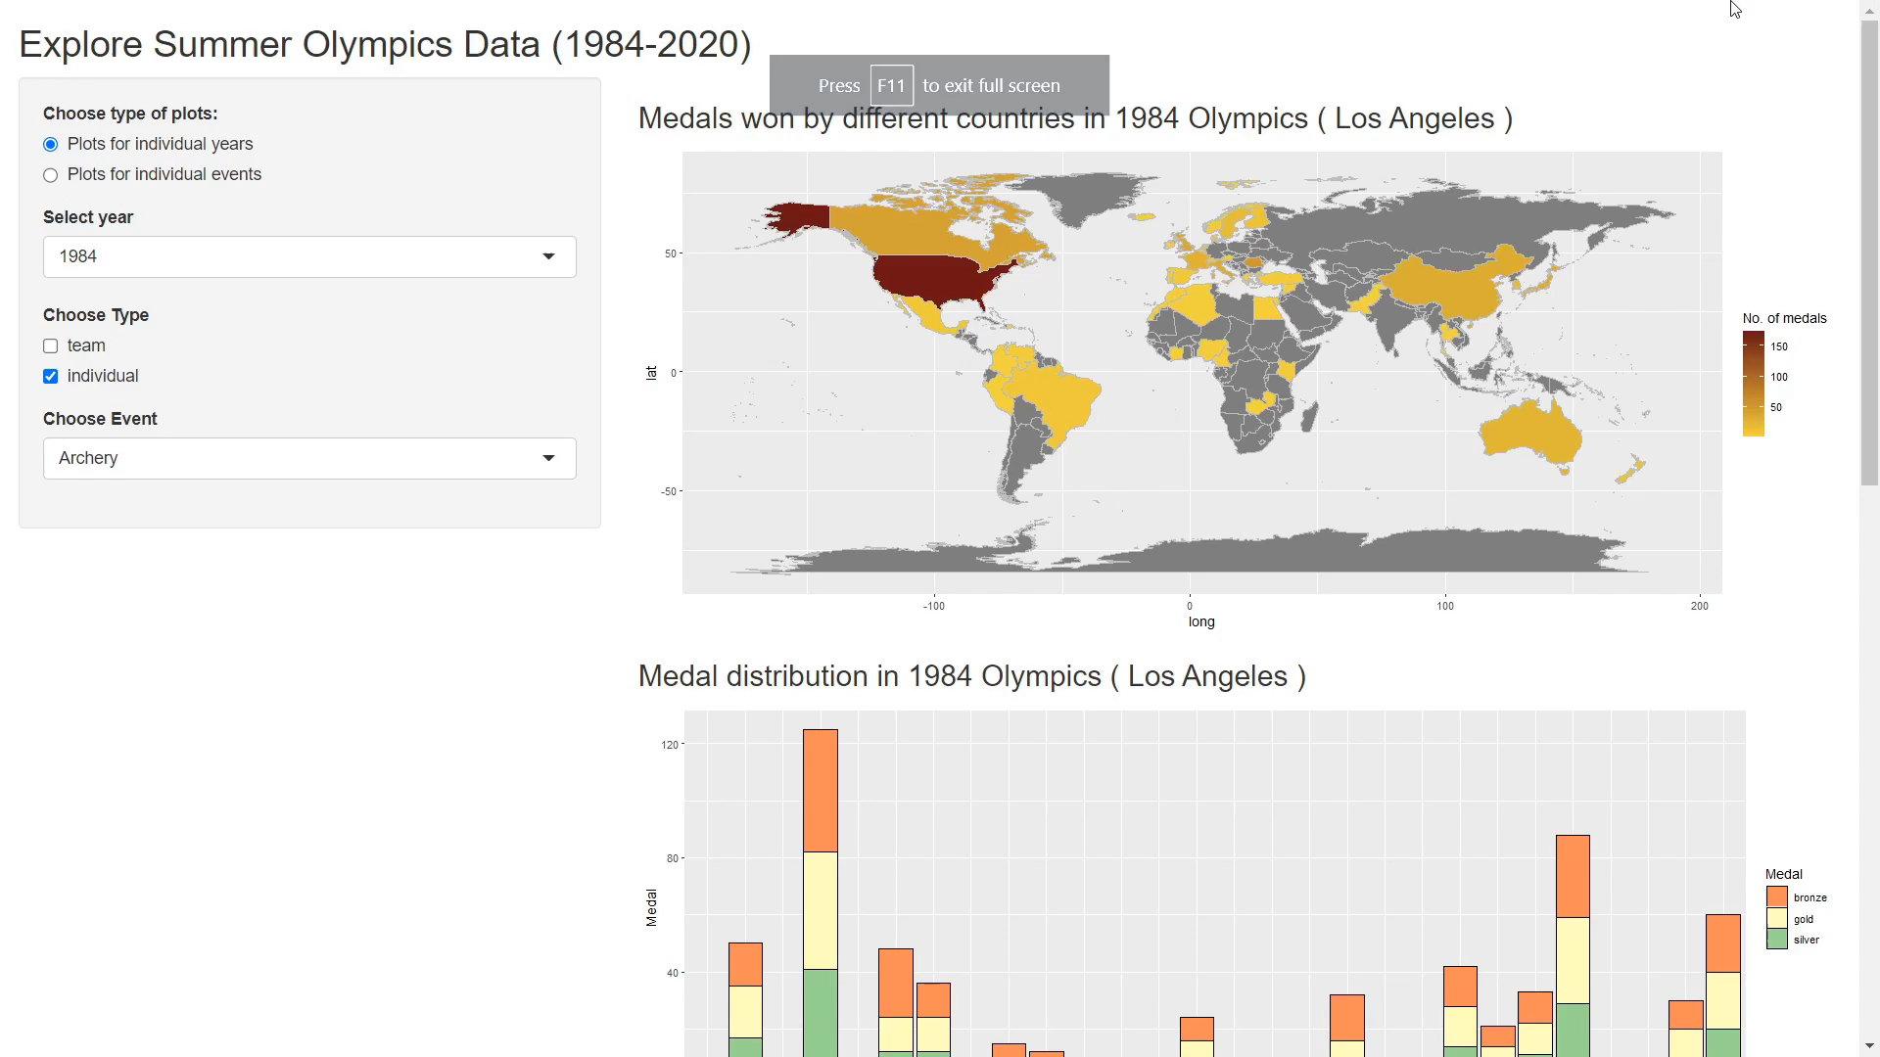

Slide 21

KEY OBSERVATIONS FROM THE PLOTS
Questions

Slide 22
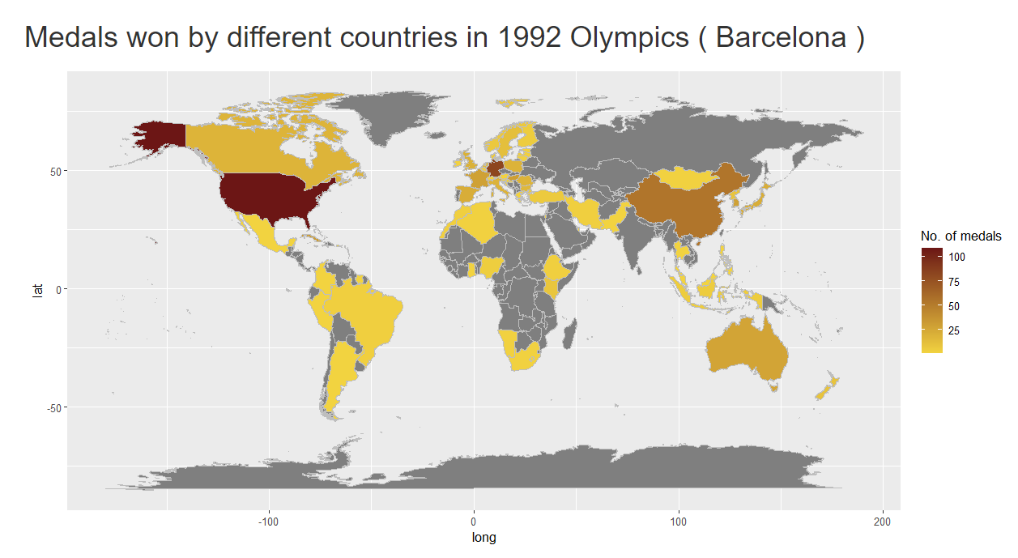

HOST COUNTRY EFFECT:
Performance of Australia improved significantly than the other years when they hosted the summer Olympic in 2000 (Sydney Olympic).

Slide 23
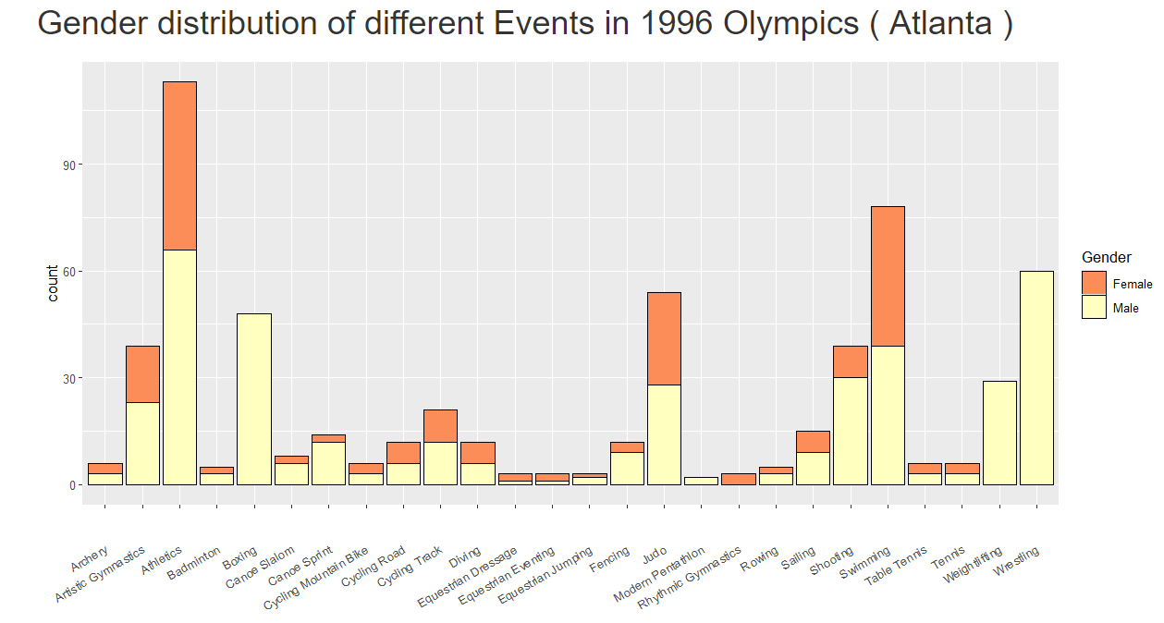
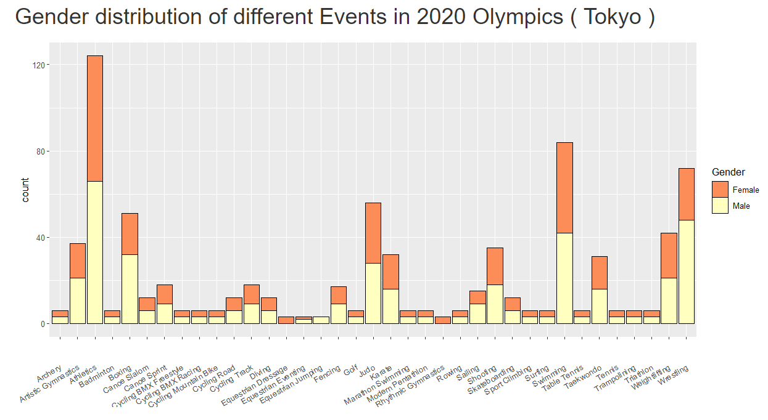
GENDER INEQUALITY IS DECREASING…
Previously in the physical games like Weightlifting, Wrestling and Boxing only male participants were allowed to participate but nowadays females are also participating in those events and winning a significant number of medals.

Slide 24
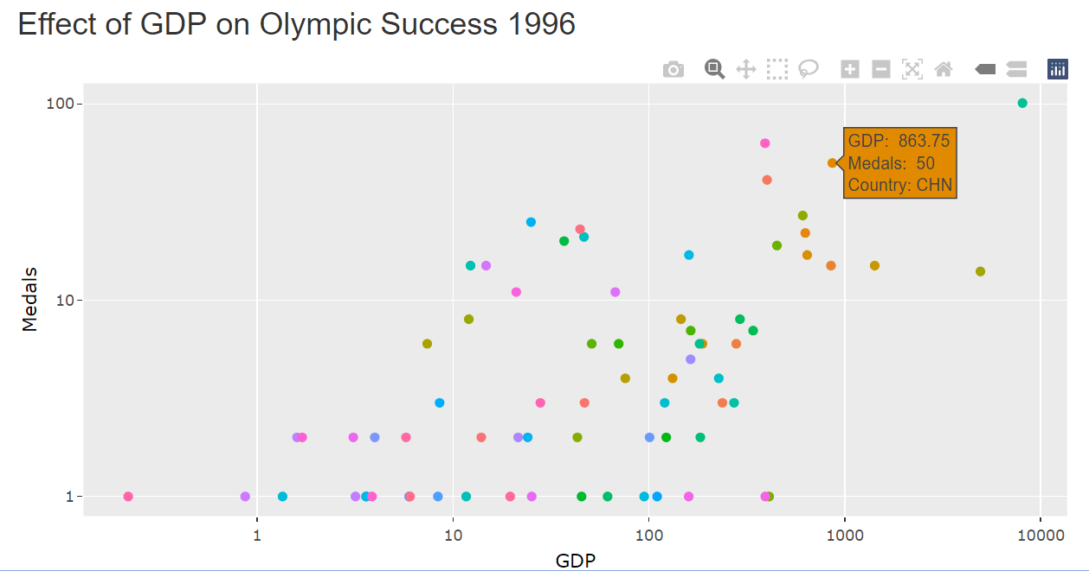
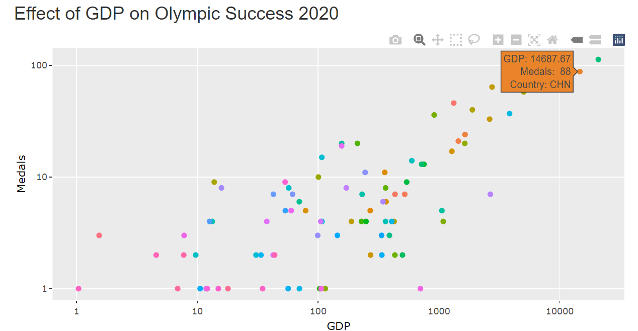
GDP EFFECT:
Number of medals won by a country seems to be positively correlated with GDP.

Slide 25



CONCLUSION
Host Country
Countries with high GDP
Optimal range of Age, Height and Weight for a particular genre

Slide 26




Meet the team
Swarnajit podder
Pratyusha sarkar
CHIRAG GARG
J S K L N M Subbarayudu​​
M.Sc. Statistics​
M.Sc. Statistics​
BS (Statistics and Data Science​)
BS (Statistics and Data Science​)

Slide 27

THANK
YOU

